Slide 1
University of Economics in Katowice
Get to know us better!

Slide 4
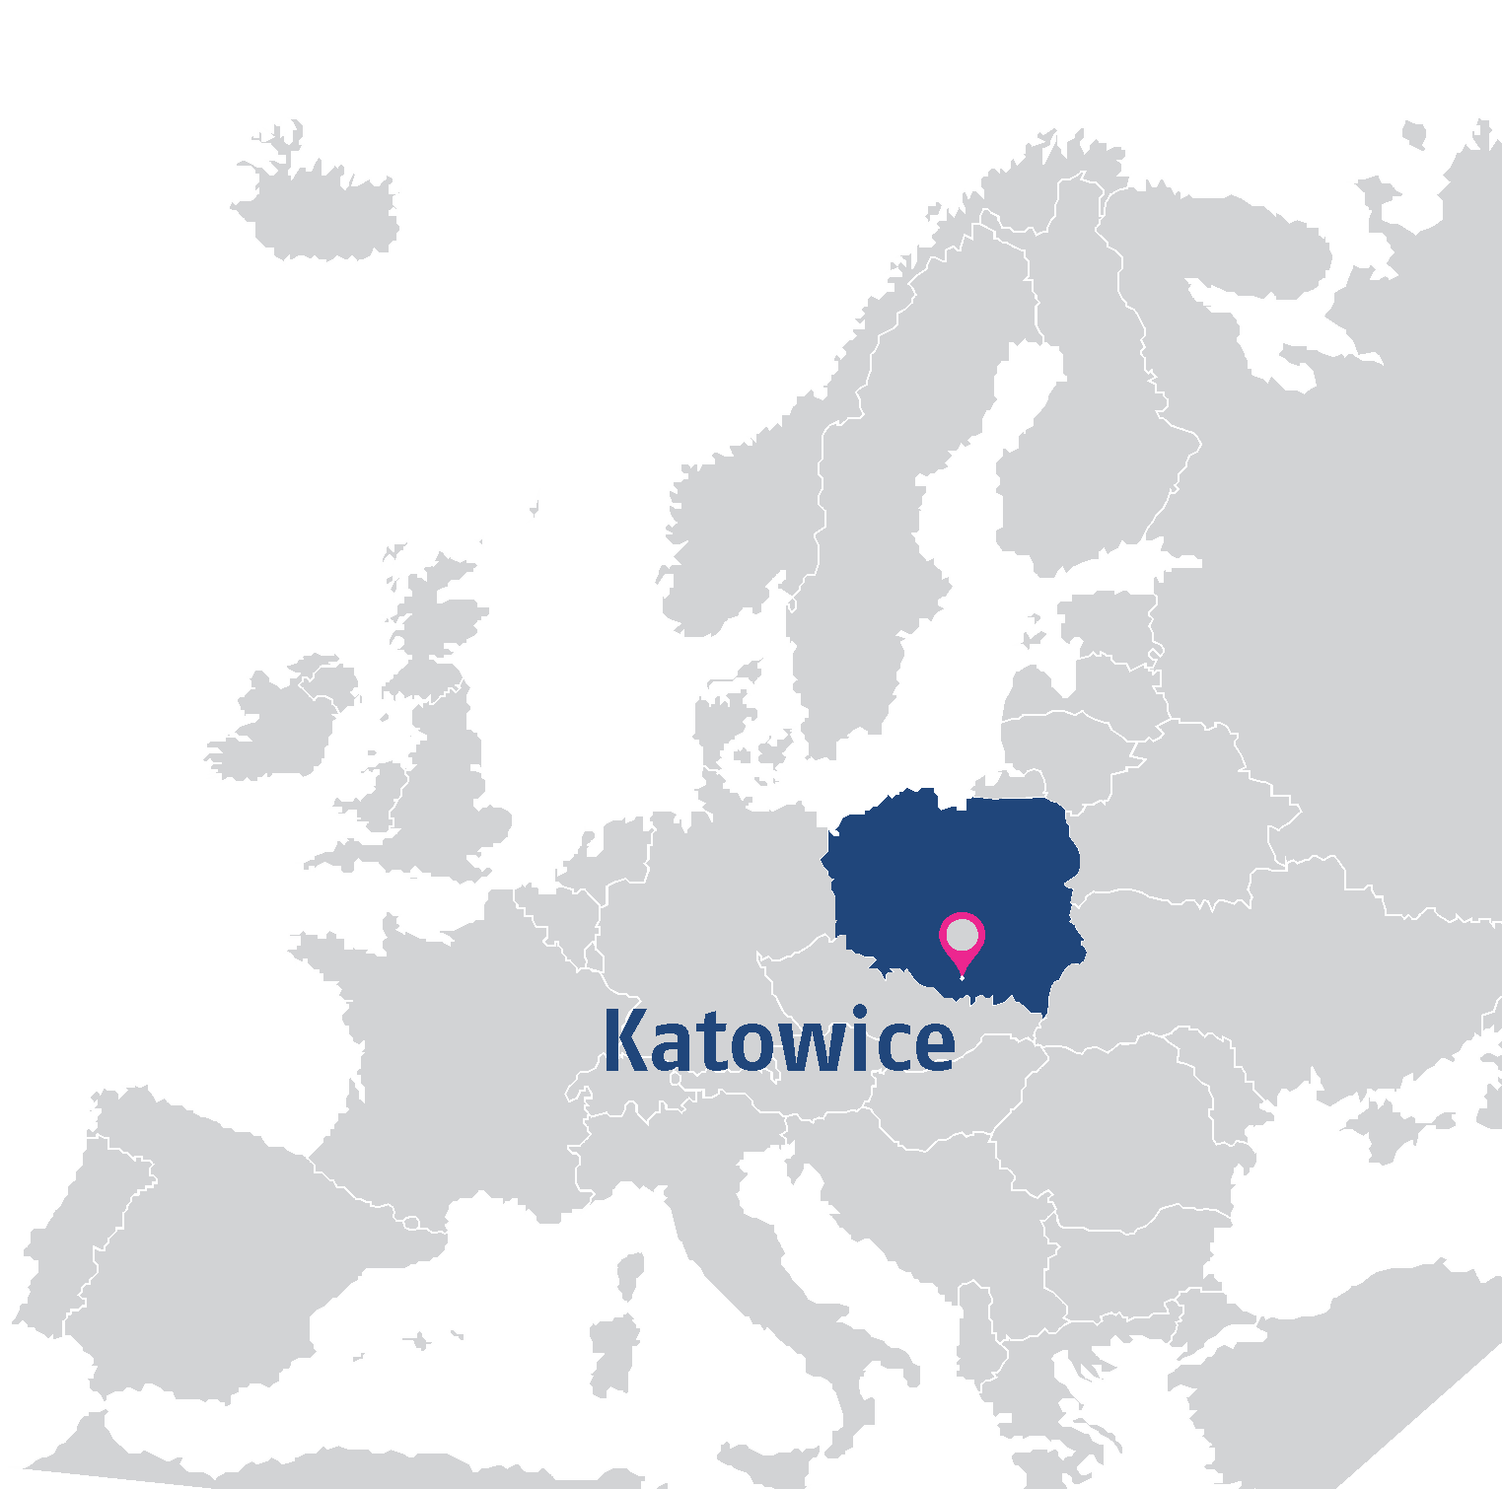
In the heart of Europe

Slide 5
Old traditions
The oldest and largest business school in Silesia (estd. 1937)

Slide 6
Facts and figures
over 80 years academic tradition (established in 1937),
about 10 000 students,
over 80 000 graduates,
about 500 academic teachers,
19 degree programmes (in Polish),
6 degree programmes (in English),
over 70 specialisations,
selection of over 80 courses (EuroClasses),
10 students organizations,
2 gyms and 1 swimming pool,
32 computer laboratories.

Slide 7
Study and international internships

Slide 8
Bachelor’s and Master’s Degree Programmes in Polish
/ Quantitative Methods for Economics and Business
/ Journalism and Social Communication
/ Economics
/ Managerial Finance
/ Finance and Accounting (Katowice)
/ Finance and Accounting (Rybnik)
/ Health Care Finance and Management
/ Economy and Public Management
/ Spatial Economics and Development
/ Travel and Tourism Management
/ Informatics
/ Informatics and Econometrics
/ Logistics
/ Logistics (Engineering)
/ International Economic Relations
/ Enterpreunership and Finance
/ Management
/ Accounting and Taxes NEW
/ Internal Security NEW

Slide 9
Bachelor degrees in English (6 semesters – ECTS: 180)
International Business
Finance and Accounting for Business
Visiting professors
Modern teaching methods
International mobility
Multicultural classroom

Slide 10
Bachelor’s Degree in International Business
You will be equipped with the knowledge necessary for doing business in European markets in relation to the global market. Get the competences and skills to manage a small or medium-sized enterprise engaged in international trade.
You may be employed e.g. in the positions of foreign trade specialists or in public administration institutions involved in international business cooperation, especially in the European Union.
Programme structure includes i.a.: Customer Behaviour, Business Statistics, Business Ethics, International Economics, International Finance, Business Law, Language for Business, Human Resource Management, Marketing Research, EU Institutions and Policies, Business Information Technology, International Trade Management, International Business Negotiations.

Slide 11
Bachelor’s Degree in Finance and Accounting for Business
The programme has been designed for students who want to:
discover the world of finance,
get an insight into the decision-making processes for companies’ financing and investments,
learn to analyse, develop and present the data on the company’s financial and economic standing,
learn to include the crucial factors for efficient financial management,
find out the role of accounting and its importance,
refine their English skills.
Employment prospects: finance and corporate accounting, controlling, business analysis, financial institutions: banks, insurance companies, investment funds.

Slide 12
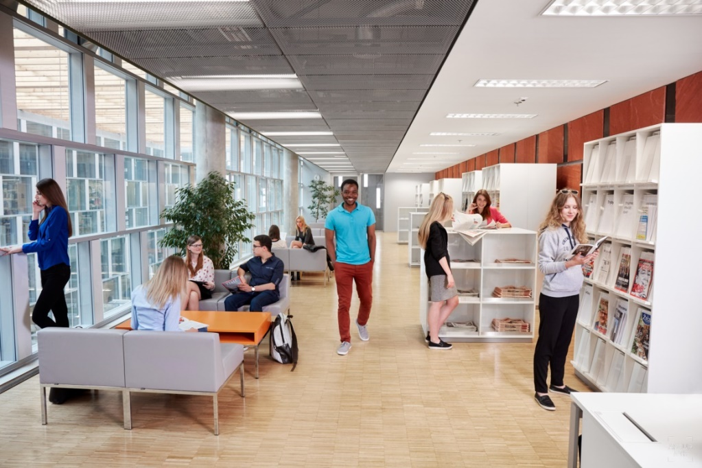
Master degrees in English (4 semesters – ECTS: 120)
Double Master’s Degree in Quantitative Asset and Risk Management
International Business
Finance and Accounting in International Business
E-commerce NEW
Double diploma
One semester worldwide placement
Students from all over the world
Visiting professors

Slide 13
Double Master’s Degree in Quantitative Asset and Risk Management
Double Degree Master Programme in ARIMA is offered in collaboration with 4 universities:
University of Applied Sciences BFI Vienna (Austria),
University of Bologna (Italy),
Alexandru Ioan Cuza University of Iaşi (Romania),
University of Economics in Katowice (Poland).
The programme is targeted at the graduates of a bachelor degree fluent in English, economics, finance, mathematics, statistics and MS Excel.
The students have the opportunity to broaden their perspectives by participating in mobility offered within the programme. Graduates receive the Master’s Diploma of the University of Economics in Katowice and – on completion of 30 ECTS in one of Partner Institution – Diploma of the Partner Institution.
University of Economics in Katowice delivering ARIMA programme is the first Polish university to receive CFA Accreditation.

Slide 14
Master’s Degree in International Business
It’s a unique opportunity to continue your business studies in the international context with solid grounding in economics, law, finance and management. Students will work in a multicultural environment and carry out projects in cooperation with students from different countries.
During the third semester of studies there is a possibility to choose between a Corporate module, constituting the advanced level of international business teaching, aimed at the undergraduates of economics and management, and a Cross-Culture module directed at students of social and humanist degree programmes.
The modern interactive teaching methods include: workshops, simulations, case studies, research projects and problem-based learning. The courses are taught by both Polish and foreign lecturers.

Slide 15
Master’s degree in Finance and Accounting in International Business
The aim of the programme is to transfer in-depth knowledge, skills and competences in the field of finance and accounting supporting business activity in an international environment. The graduate should understand the processes taking place in the international business environment.
The acquired knowledge, skills and competences are focused on the international understanding of such problems as: Strategic financial management, Financial risk management, Accounting and auditing from international perspective, Strategic management, International marketing, International human resources management, Corporate tax management, IT tools necessary for effective analysis of financial data etc.
Graduates will be prepared to perform managerial functions. They will become qualified specialists prepared to work in international non-financial corporations and financial institutions.

Slide 16
Master’s Degree in E-commerce NEW
A graduate of E-Commerce has knowledge and skills in the field of:
functioning of the e-commerce system,
management of e-commerce projects,
e-commerce techniques and organization,
logistics aspects of purchase and sale of products in diversified sales channels,
legal issues, including data protection in e-commerce,
entrepreneurship and innovation in e-commerce,
analysis of data for the purposes of e-commerce analysis in Google Analytics, Qlik, SPSS, Business Intelligence systems, Data Science issues,
multi-channel communication and distribution in e-commerce (omnichannel),
using social media in promotion, advertising and creating the company's image and planning marketing campaigns in Google Ads.
After graduation, it is possible to work as: e-commerce specialist, e-commerce project coordinator, an internet marketing specialist, administrator of e-commerce platforms, e-commerce analyst, expert and consultant in the electronic business sector (IT industry, e-commerce), e-entrepreneur.

Slide 17
Short-term students in English
Students from abroad have the opportunity to spend one or two semesters at the University of Economics in Katowice within the following programmes:
Erasmus+ with Programme Countries,
Erasmus+ with Partner Countries,
Double Degree,
CEEPUS (Central European Exchange Program for University Studies),
Bilateral Agreements.
While studying at the University of Economics in Katowice students can take advantage of:
a wide offer of courses in English, both on Bachelor and Master level, focused on business, economics, management and IT,
studying in a rapidly-developing city located in the heart of Europe,
support from the Erasmus Student Network coordinating the mentor programme and social events and activities.

Slide 18
Short-term students in English
EuroClasses
It’s selection of over 80 courses. Foreign exchange students can choose from a wide range of subjects offered across the degree-programmes of the University of Economics in Katowice.
Orientation Programme
Organised before each semester begins. Polish mentors prepare events to welcome new exchange students and provide assistance them during their first days.
International Weeks
The purpose of the event is to intensify international collaboration with our partners in the fields of teaching, studies and international collaboration in general.
Each registered student can participate in 1 course and get 3 ECTS on completion within one week only. The course topics are interdisciplinary and the courses are intended for students with a variety of specialisation belonging to different study programmes.

Slide 20
Learning by doing
At our University you can find 10 student’s organizations and over 40 student’s scientific clubs which can improve your knowledge and skills, help you make contacts and friends as well as gain experience.

Slide 21
Passion
Students can develop their music and dance talents
in Song and Dance Ensamble Silesianie

Slide 22
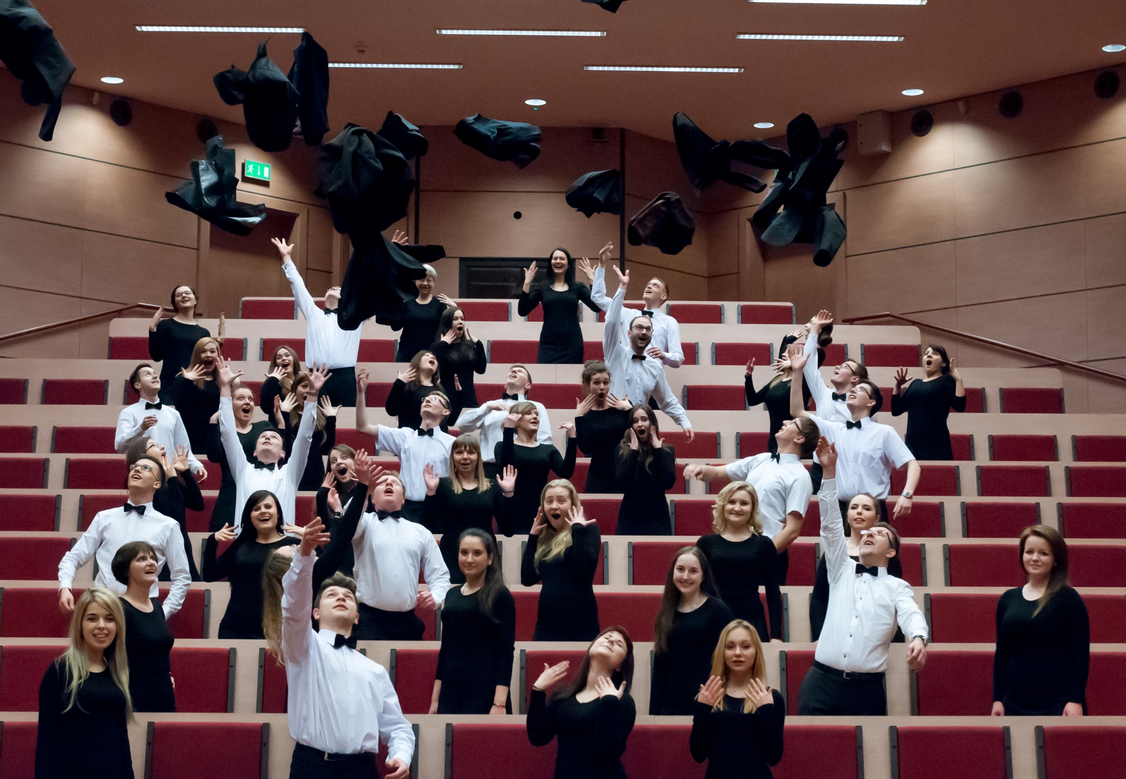
Passion
With University Academic Choir you can take part in concert tours all over the world.

Slide 23
Passion
You can also develop your sports interests and skills in both individual
and team sports in Academic Sports Association.

Slide 24
^{Career support programme}
/ Active support for students and graduates seeking job placement,
/ Practical internships,
/ Tips for active job search,
/ Consultancy service for preparing application documents,
/ Preparing for interviews,
/ Presentations of well-known companies,
/ Assistance in developing a long-term career and personal career path.

Slide 25
How to apply?

Slide 26
Application process step by step
Long-term students
Log in to our application system, choose your field of studies and fill in the application form;
Scan your documents and upload them to the system;
Pay the admissions fee;
When the verification will be positive, and the documentation will be complete, you will receive an invoice for the first semester fee;
Apply for a visa in a Polish consulate;
Come to Poland and start the adventure!

Slide 27
Application process step by step
Exchange students
Nomination via e-mail sent by your Home Coordinator;
Receiving an e-mail with the access to the online application system;
Filling in the application form and choosing the subjects in the on-line system;
Downloading and printing your Application Form and Learning Agreement;
Having the documents signed and sealed by your Home Coordinator;
Uploading the documents in the system within the given deadlines;
Downloading your Letter of Acceptance from the system;
Preparing yourself for your stay at the University of Economics in Katowice;
Come to Poland and start the adventure!

Slide 28
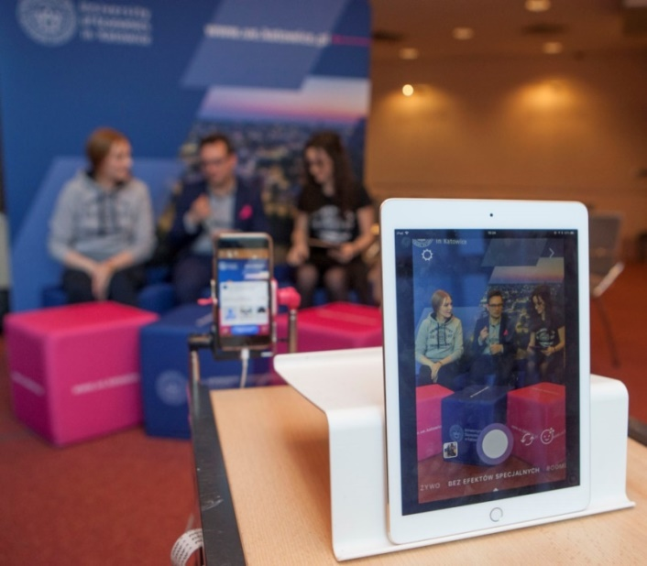
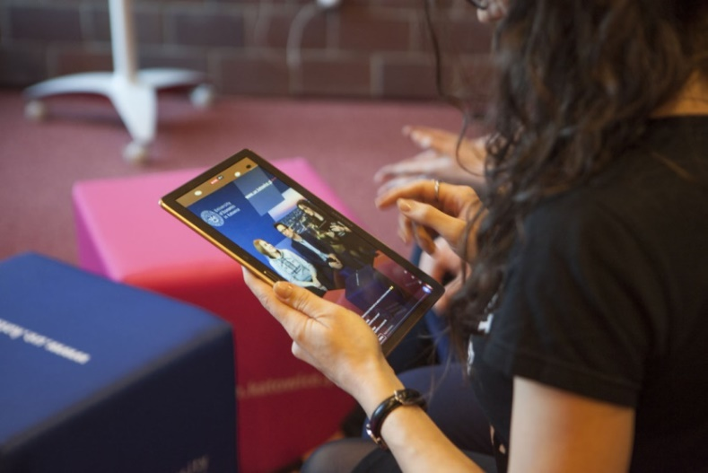
If you have any questions, contact us!
Admissions Office Tel.: +48 32 257 7058 E-mail: admissions@ue.katowice.pl
www.ue.katowice.pl/facebookEN
www.instagram.com/uekatowice

