Slide 1

International Relations (IRO UEKat) Online Application System

Slide 2
International Relations (IRO UEKat) Online Application System

Slide 3
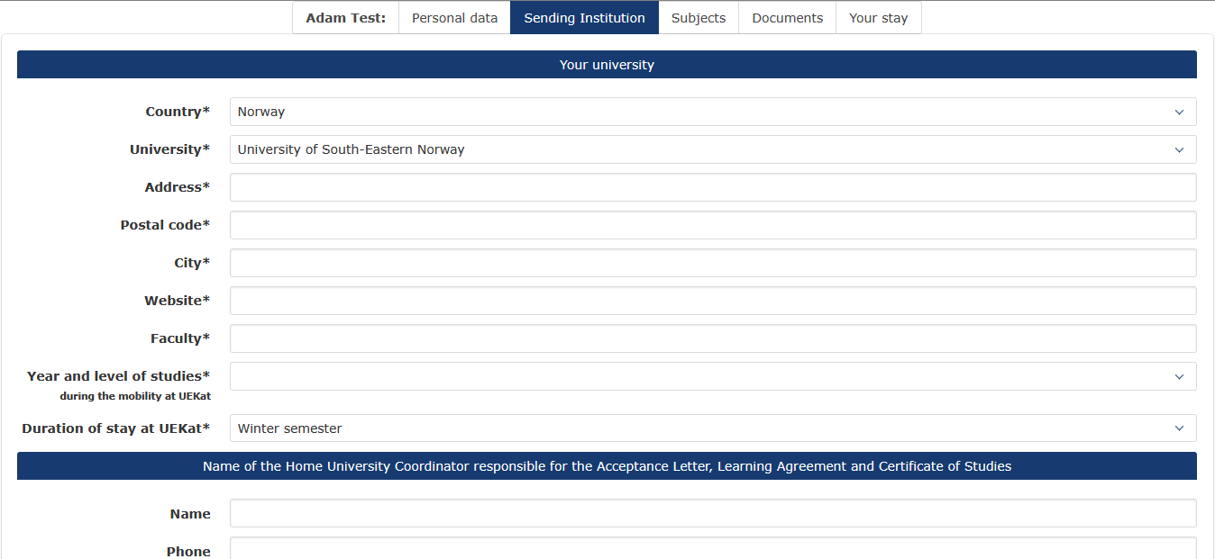
International Relations (IRO UEKat) Online Application System

Slide 4
International Relations (IRO UEKat) Online Application System

Slide 5
International Relations (IRO UEKat) Online Application System

Slide 6
International Relations (IRO UEKat) Online Application System

Slide 7
International Relations (IRO UEKat) Online Application System

Slide 8
International Relations (IRO UEKat) Online Application System

